Slide 1
Acute epidemiological disease

Slide 2
Anthrax
Causative agent: bacteria called Bacillus anthracis
It is zoonotic disease(human, cattle and sheep).
Signs: cause sudden death.
Bulging of the carcass.
Exit the blood from the openings of the body without clotting.
Prevention :by vaccination.
Treatment: Penicillin

Slide 3
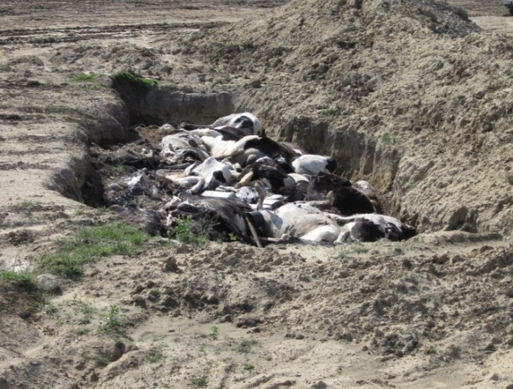

Slide 4
Rinder pest
Causative agent: Morbilivirus genus.
An infectious viral disease of cattle and domestic buffalo.
The disease was characterized by fever, oral erosions, diarrhea, lymphoid necrosis and high mortality.
Rinder pest was mainly transmitted by direct contact and by drinking contaminated water, although it could also be transmitted by air.

Slide 5
Generally there is sudden onset of fever, followed by depression, loss of appetite, reduced milk production, nasal and eye discharges and labored, rapid breathing.
Severe lacrimation (tearing) and salivation occurs, eventually turning purulent and possibly blood-stained. Necrotic lesions occur in the mouth, lining of the nose, and genital tract. The lesions also occur in the intestine, leading to acute diarrhea and dysentery.
Most animals die 6–12 days after onset of clinical signs.

Slide 6
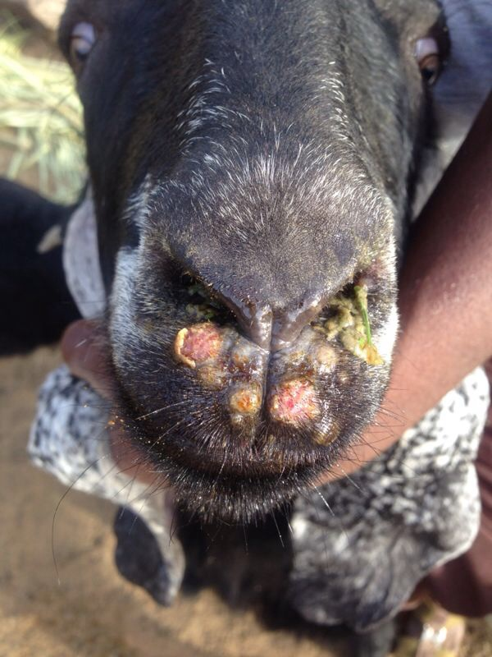
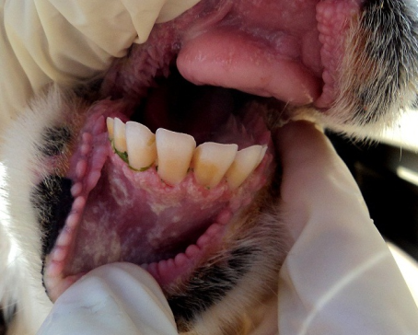
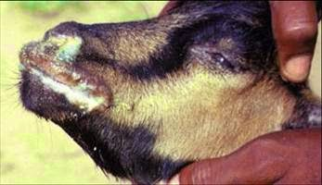

Slide 7
Foot and mouth disease(FMD)
An infectious and sometimes fatal viral disease caused by picorna virus that affects cloven –hoofed animals, including domestic and wild bovine.
Contact with contaminated farming equipment, vehicles, clothing and feed.
The disease is characterized by high fever that declines rapidly after two or three days, blisters inside the mouth that lead to excessive secretion of stringy or foamy saliva and to drooling, and blisters on the feet that may rupture and cause lameness.

Slide 8
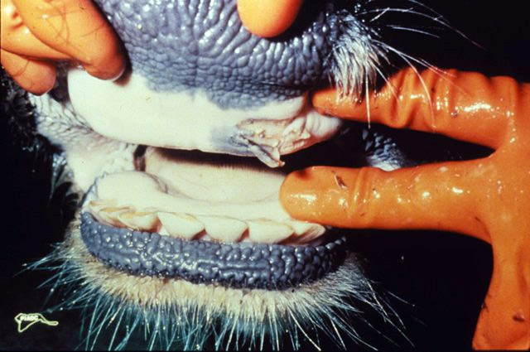
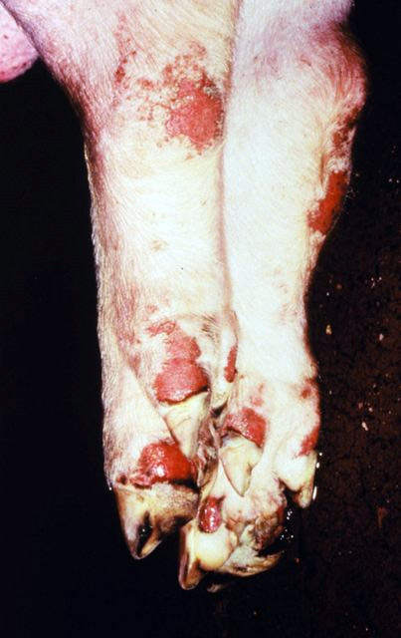

Slide 9
Black leg
An infectious bacterial disease most commonly caused by Clostridium chauvoei.
usually affecting cattle, sheep, and goats.
The hind limbs usually swells significantly, and the animal can develop lameness on the affected leg. Crepitation (the sensation of air under the skin) can be noticed in many infections, as the area seems to crackle under pressure.

Slide 10
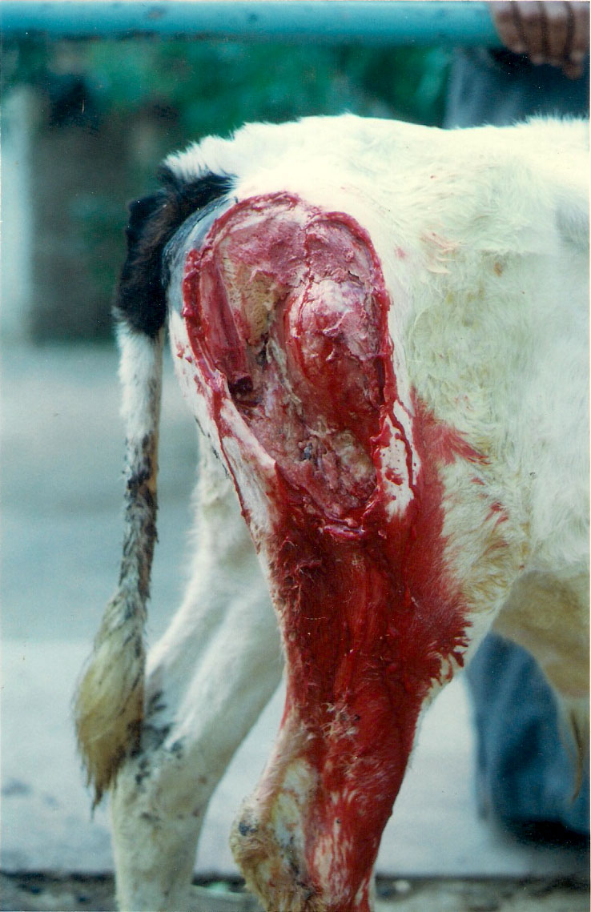

Slide 11
Chronic diseases
Tuberculosis
an infectious disease usually caused by Mycobacterium tuberculosis (MTB) bacteria.
Tuberculosis generally affects the lungs
he classic symptoms of active TB are a chronic cough with blood containing sputum, fever, night sweats, and weight loss.

Slide 12
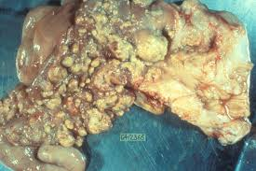
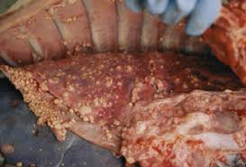

Slide 13
Brucellosis
A highly contagious zoonotic disease. Causes abortion in the last months of pregnancy Caused by Brucella abortus.

Slide 14
Parasitic diseases
Tick fever
Caused by protozoa, increase body temperature cause destruction of RBC ,It results in discoloration of the urine in red. The disease transmitted by tick.

Slide 15
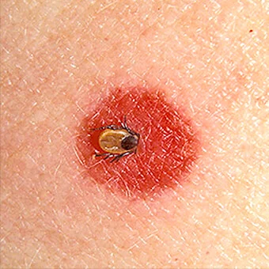

Slide 16
Anaplasmosis
Caused by blood parasite called anaplasma that live inside RBC. Caused anemia.

Slide 17
Theileriasis
Caused by blood parasite called Theilaria.
Signs: swollen of lymph nodes, urine discoloration with yellow color.

Slide 18
Parasites of digestive system and lungs
Haemonchus: affected calves, caused anemia, bulgy jaw, diarrhea and loss of body weight.
Hook worms: caused anemia and dysentery.
Tape worms: affected small calves, caused Scratching of the intestinal wall and obstruction it.

Slide 19
Liver flukes: affect bile duct.
Its dangerous because inflammation of bronchus.
Ring worm: its skin disease caused by fungi, regular lesion.
Mange: irregular lesion caused by mites.

Slide 20
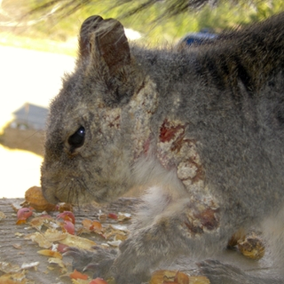
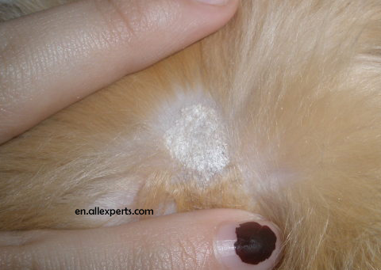

Slide 21
Mastitis
It is inflammation of the udder, caused by bacteria such as Staphlococcus, Pasteurella or fungi such as Candida albicans.
This disease has economic importance which is lead to decrease milk production, deterioration of animal health And the inability of females to continue birth and production. The udder become hot, painful, engorged with touch and enlarged in size.
The milk may contain clipped parts , the color become yellow or may contain blood.

Slide 22
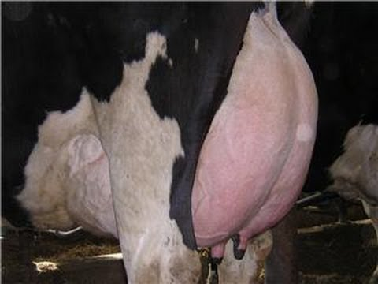
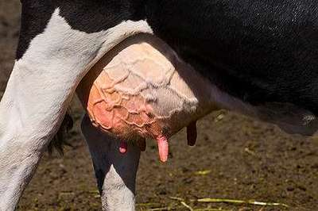

Slide 23
Sheep pox
is a highly contagious disease of sheep caused by a poxvirus.
Signs: increased temperature, conjunctivitis, and swollen lymph nodes.
The skin lesions are most common on the muzzle, ears, and areas that are free of wool. Lesions on the skin quickly become raised due to local inflammation and edema.

Slide 24
At the beginning of the disease, small granules are formed into small vesicles and then become a pustules.

Slide 25
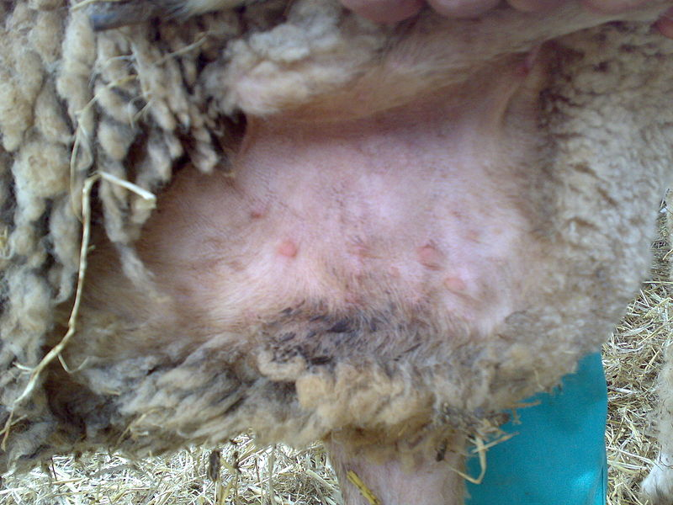

Slide 26
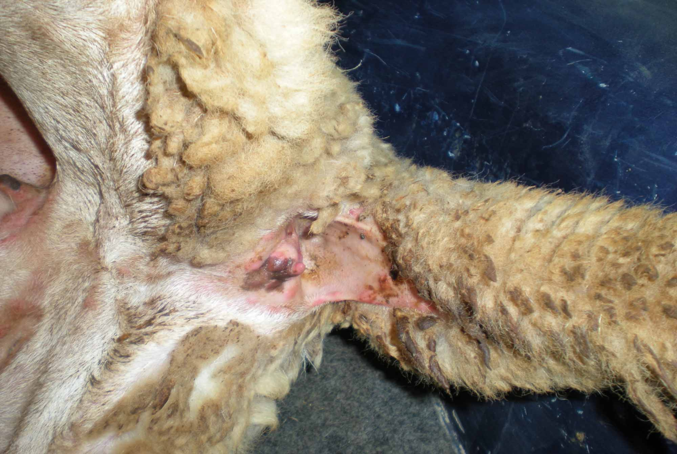

Slide 27
Entero toxaemia
Caused by bacteria called Clostridium perferenges. This bacteria produce enterotoxin that has a illness effect on the host. It is believed that the sudden switching of food from green fodder to concentrated effect of the disease.

Slide 28
Equine disease
Glanders
Caused by Streptococcus bacteria .It is dangerous, zoonotic disease and fatal, may affect the skin, lungs and upper respiratory system.

Slide 29
Symptoms:
Deep ulcers and nodules inside the nasal passages.
Pneumonia.
Swollen lymph nodes.
Skin rash with pustules.

Slide 30
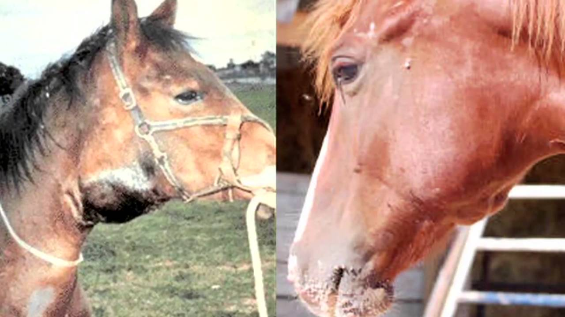

Slide 31
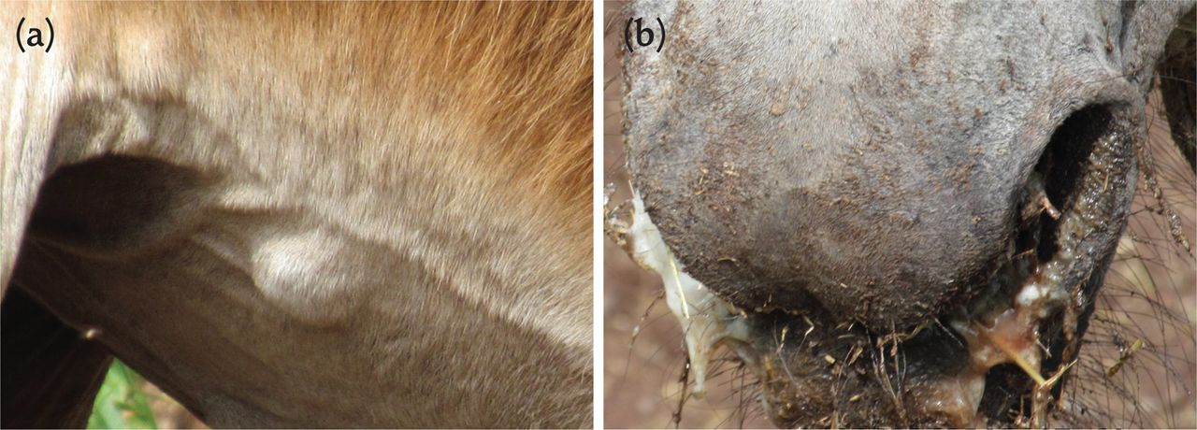

Slide 32
Strangles
Caused by Streptococcuc bacteria.
Infects small horses while not adult.
The disease is characterized by pus and spoils.
When healing the animal acquires permanent immunity.

Slide 33
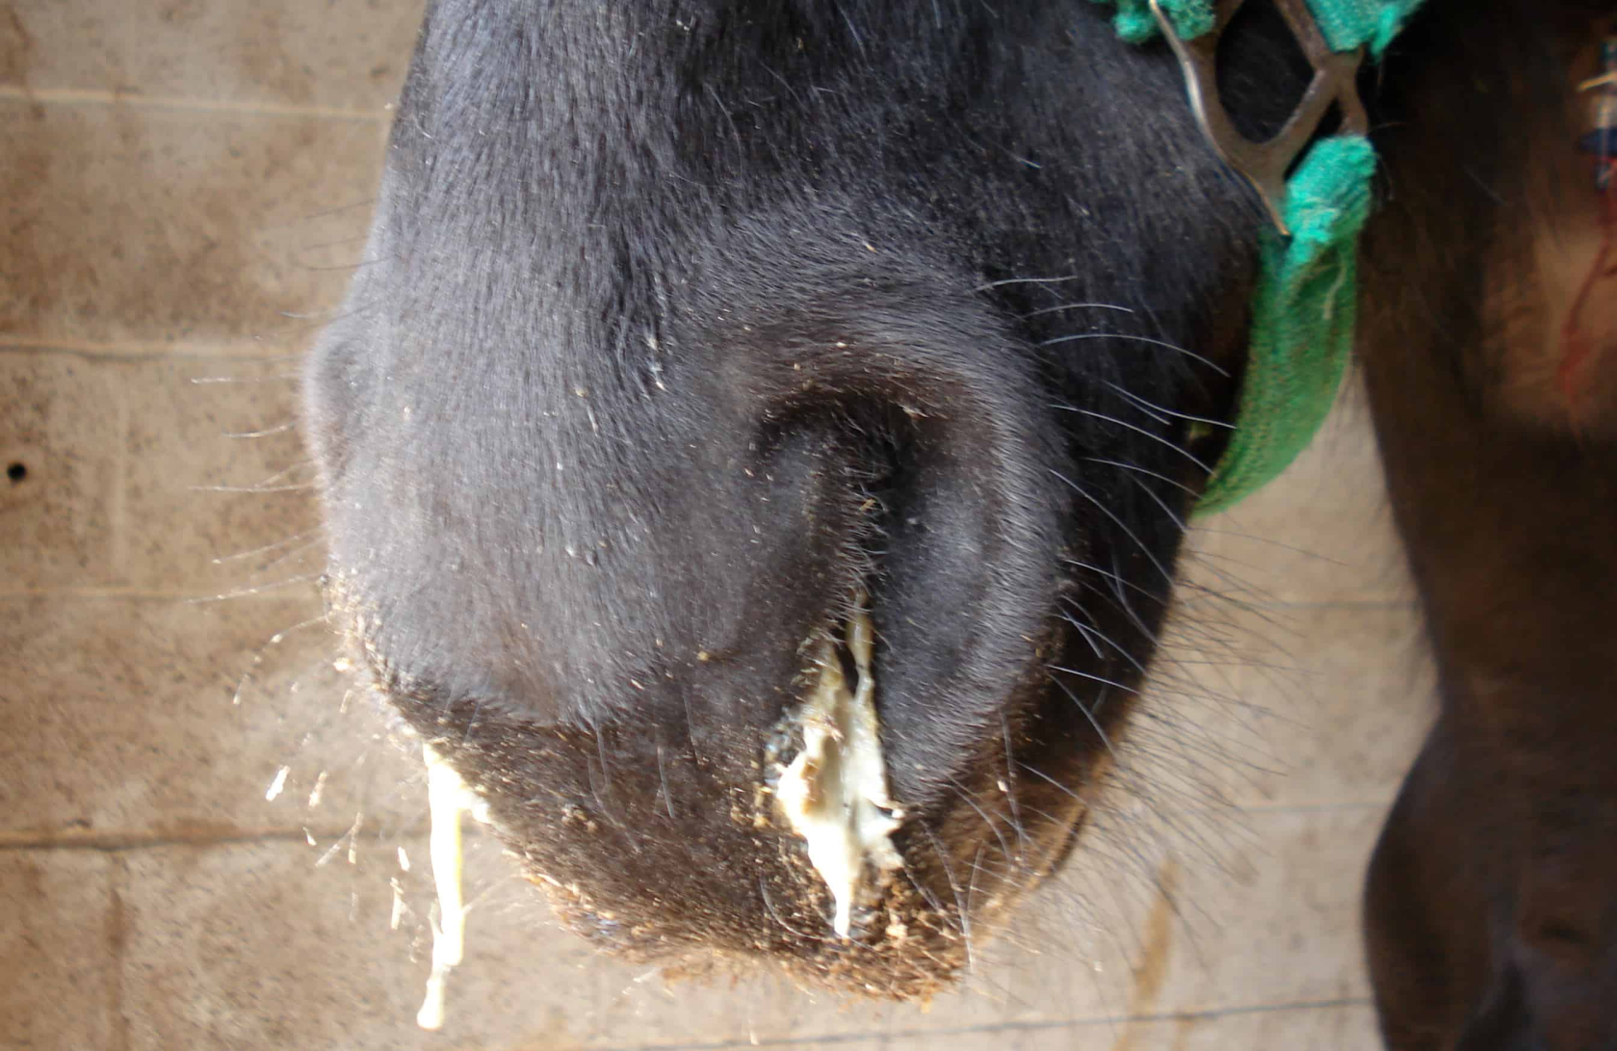

Slide 34
Parasitic diseases
Babesia
It is blood parasite live in the RBC which cause destruction of it. This destruction lead to severe anemia and the color of urine is red.

Slide 35
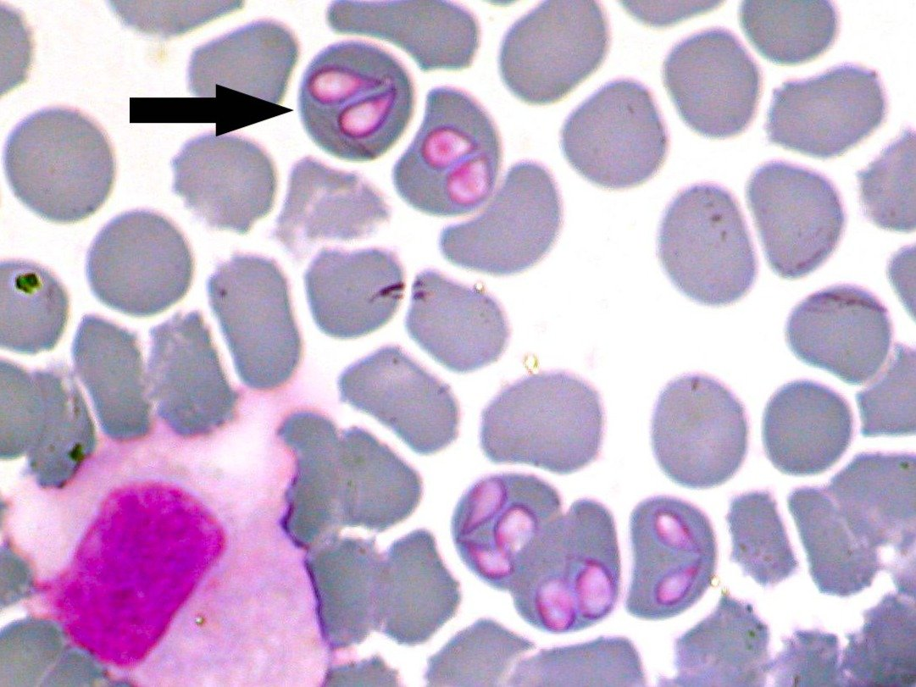

Slide 36
Strongylus vulgares
It cause block out of mesentric arteries, which lead to cause severe colic in the abdominal regien.

Slide 37
